Slide 1
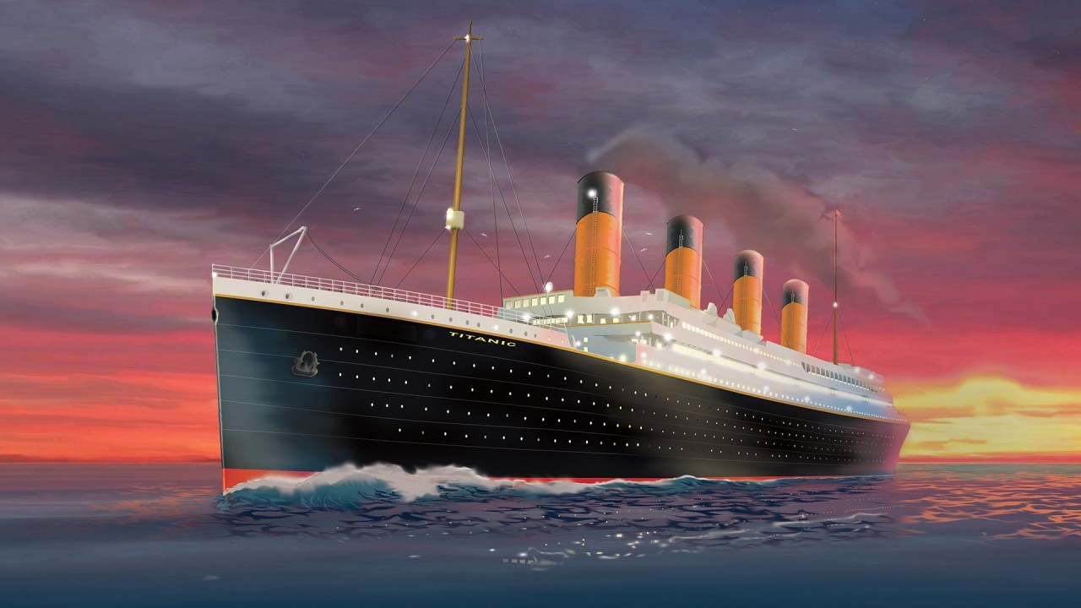
Titanic Dataset Exploratory
Data Analysis
Presented By: SHERIN SAMUEL Data Analyst | AI & ML Enthusiast

Slide 2
OBJECTIVE
Perform Exploratory Data Analysis on Titanic Dataset
Visualize trends using Seaborn and Matplotlib
Summarize findings for future machine learning modeling
Understand relationships between features and survival

Slide 3
Tools & Technologies
Languages: Python
Libraries: Pandas, NumPy, Seaborn, Matplotlib
Platform: Jupyter Notebook
Dataset: Titanic Passenger Data (train.csv)

Slide 4
Dataset Overview
891 records with 12 features
Key columns:
Survived, Pclass, Sex, Age, SibSp, Parch, Fare, Embarked
Missing values in:
Age, Cabin, Embarked

Slide 5


EDA Techniques Used
Descriptive Statistics
info()
describe()
Visualization
Pairplot
value_counts()
Correlation Heatmap
Histograms
Boxplots
Scatterplots

Slide 6
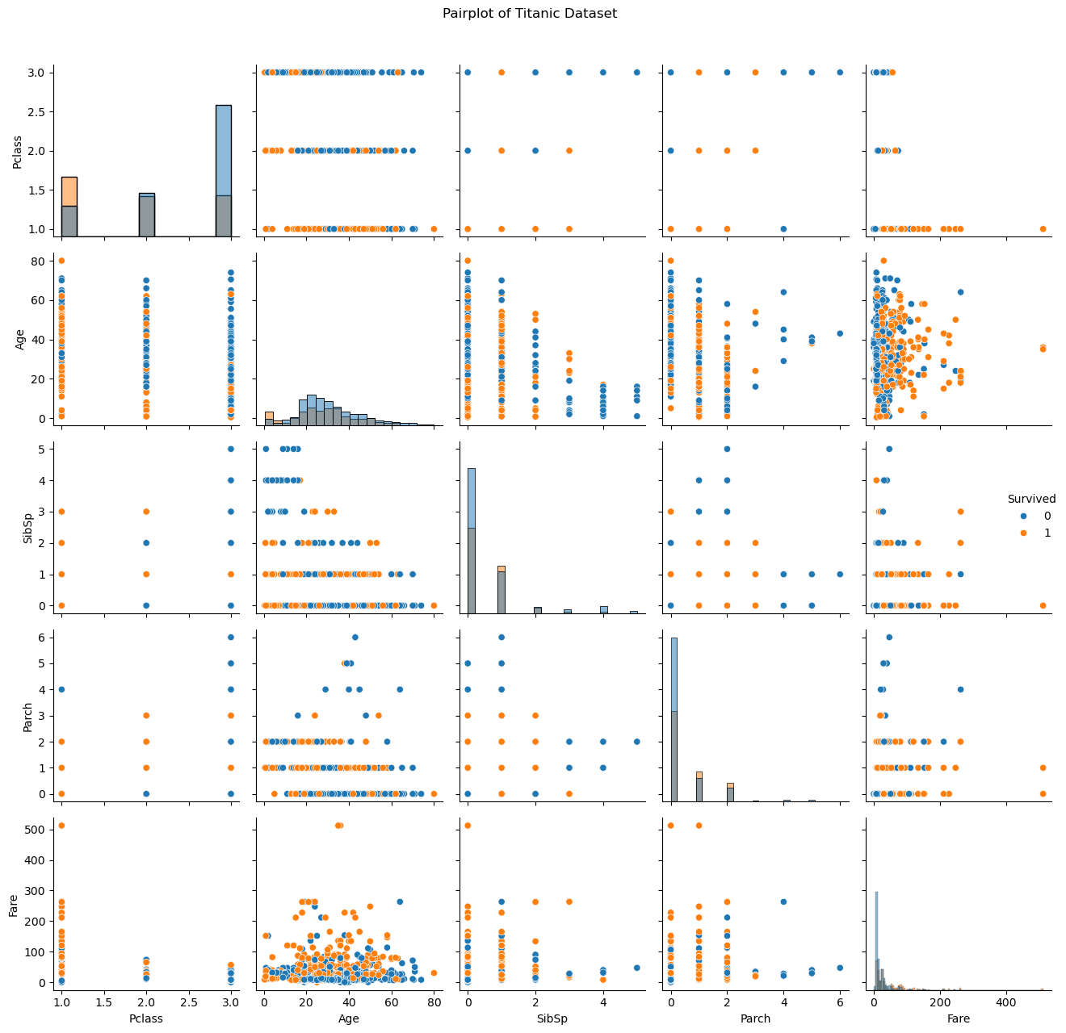
Pairplot
The pairplot confirms that Pclass, Sex, Age, and Fare are crucial factors influencing survival

Slide 7
Observations from the Pairplot
1. Pclass vs Survived
More survivors in 1st class (Pclass = 1).
Passengers in Pclass 3 had the highest number of non-survivors.
Indicates a strong influence of passenger class on survival.
2. Age vs Survived
Younger passengers (especially children) had a higher chance of survival.
Many older passengers didn’t survive — a trend in both genders.
3. Fare vs Survived
Passengers who paid higher fares were more likely to survive.
Lower-fare passengers had lower survival rates — correlates with lower Pclass.
4. SibSp (Siblings/Spouses)
Survival seems higher when SibSp is 1–2.
Very few passengers with high SibSp survived.
5. Parch (Parents/Children)
Those with small family sizes (Parch = 1 or 2) had better survival rates.
Extremely high Parch values were rare and did not correlate strongly with survival.
6. Fare vs Pclass
Expected positive correlation — higher classes had higher fares.
Confirms the socio-economic influence on survival.

Slide 8
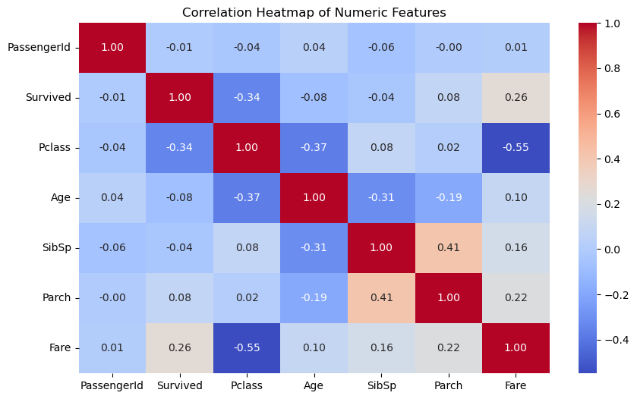

Slide 9
Observations from the Correlation Heatmap
🎯 Target Variable: Survived
Positively correlated with Fare (0.26): → Passengers who paid higher fares were more likely to survive.
Negatively correlated with Pclass (−0.34): → Lower class (higher number) passengers had lower survival rates.
📊 Other Significant Relationships
Pclass vs Fare (−0.55): → Strong inverse correlation — higher class passengers paid more.
SibSp vs Parch (0.41): → Families traveling together had similar counts of siblings/spouses and parents/children.
Age shows weak correlations with all other features.
🧊 Low/Negligible Correlations
PassengerId is essentially uncorrelated with all features (as expected — it's just an identifier).
Age has a mild negative correlation with SibSp (-0.31) — possibly younger passengers traveled with siblings.

Slide 10
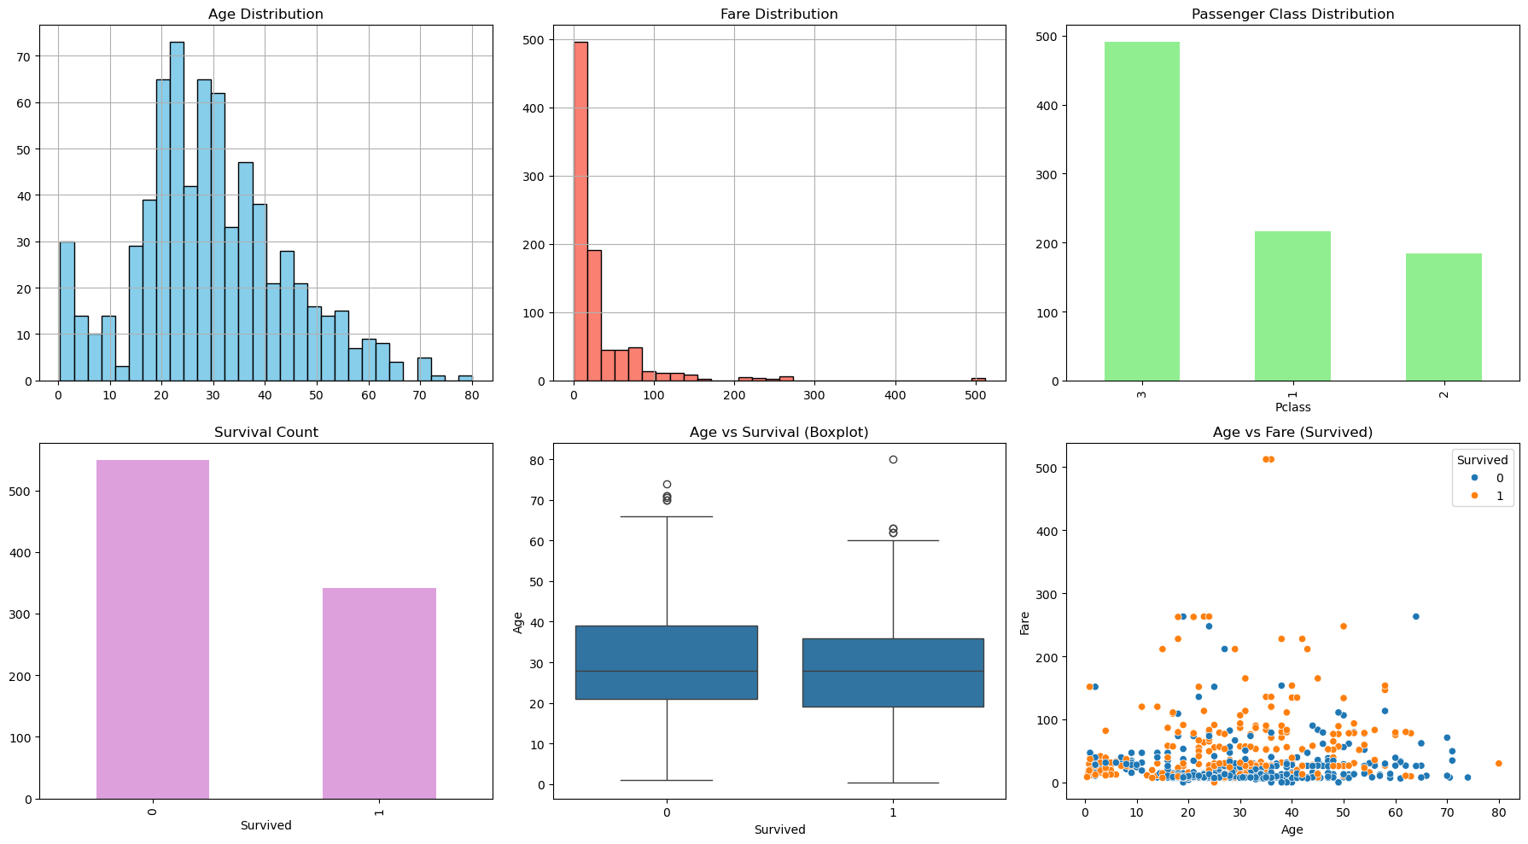
Age vs Survival: Children had higher survival
Fare vs Survival: Higher fares linked to better survival
Sex: Females had higher survival rate
Pclass: Passengers in 1st class had highest survival

Slide 11
Summary of Findings
Sex and Class are strongest survival indicators
Younger passengers and higher fare = greater chance of survival
Feature engineering suggested for ML models:
Family size
Age bands
Title extraction from names

Slide 12
Future Work
Handle missing data more robustly (Age, Cabin)
Perform feature engineering
Build classification model (Logistic Regression, Random Forest)
Hyperparameter tuning & performance evaluation

